Slide 1
Computerized Dance Classroom
Subtitle
names

Slide 2
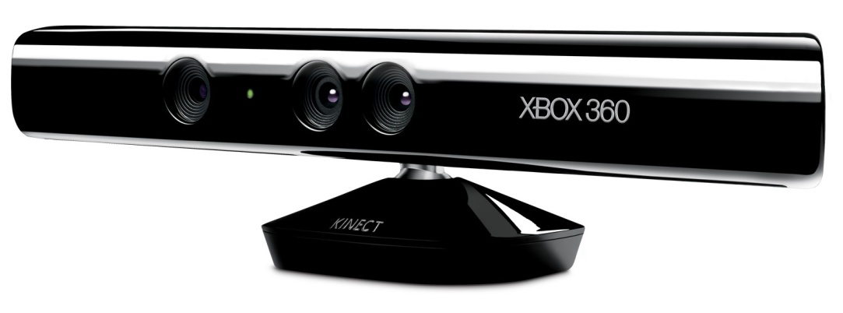


Project Background
RGB-D cameras:
Microsoft Kinect
Asus Xtion
other
OpenNI
NiTE
Notes:
An emergence of RGB-D cameras, such as Microsoft Kinect or Asus Xtion, has lead a development of applications with a completely new type of user interaction
With an RGB-D camera, users are not required to hold any controllers in their hands, but perform gestures in front of the camera, which are automatically interpreted by the device

Slide 3
Outline
Project Aims
Evaluation
The Application
Features
Algorithms
Extensions

Slide 4
Project Aims
Bring Kinect technology to a dance classroom
Evaluate tracking capabilities of Kinect, OpenNI and NiTE
Develop software for recording dance performances
Create algorithms for automatic recognition of errors and comparing two dance movements
Make the application user friendly

Slide 5
Evaluation of Kinect, OpenNI and NiTE
Camera range:
60 cm – recognises subjects
120 cm – starts tracking
410 cm – stops tracking
Lighting conditions:
No effect on the tracking capabilities
Velocity of movement
Faster movement can decrease the precision of data returned from NiTE
Camera angle relative to the performers
If a person stands at a 90° to the camera, it can lose tracking of the limbs which are covered by the body

Slide 6
Evaluation of Kinect, OpenNI and NiTE
Interference between multiple cameras
Careful placement of cameras can minimise the interference
Occlusion in front of the camera
Creates a problem, camera loses tracking if a part of the body is covered by an object
Number of tracked people
In theory constrained only by how many can actually fit in the camera range
In practise, inevitable occlusion between multiple people limits the number to about 2

Slide 7
The Application
Screenshots?
Features

Slide 8
The Application
Screenshots?
Features

Slide 9
The Application
Screenshots?
Features

Slide 10
Automatic Dance Scoring - Algorithm
Motionless Activity Detector
Translation Module
Score
Data Alignment Module
Data Analysis Module
Dance
Overall, high level description of the system

Slide 11
Automatic Dance Scoring - Algorithm
Motionless Activity Detector
Some info + maybe a figure before/after
Translation Module
Some info + maybe a figure before/after

Slide 12
Automatic Dance Scoring - Algorithm
Data Alignment Module
Some info + maybe a figure before/after
Data Analysis Module
Some info

Slide 13
Extensions
Machine learning

Slide 14
Limitations

Slide 15
Summary

